Slide 1

Algebra 1
Unit 2, Lesson 3 Applying Exponent Laws to Generate Equivalent Algebraic Expressions Volume 1, pg. 67

Slide 2


Benchmark
MA.912.NSO.1.2
Generate equivalent algebraic expressions using the properties of exponents.
volume 1, pg. 67

Slide 3
Integrated Mathematical Thinking and Reasoning Standards
MA.K12.MTR.2.1 Demonstrate understanding by representing problems in multiple ways.
MA.K12.MTR.4.1 Engage in discussions that reflect on the mathematical thinking of self and others.
MA.K12.MTR.5.1 Use patterns and structure to help understand and connect mathematical concepts.
volume 1, pg. 67

Slide 4

Learning Target
I can generate equivalent algebraic expressions using properties (laws) of exponents.
volume 1, pg. 67

Slide 5

Warm-Up
volume 1, pg. 68

Slide 6
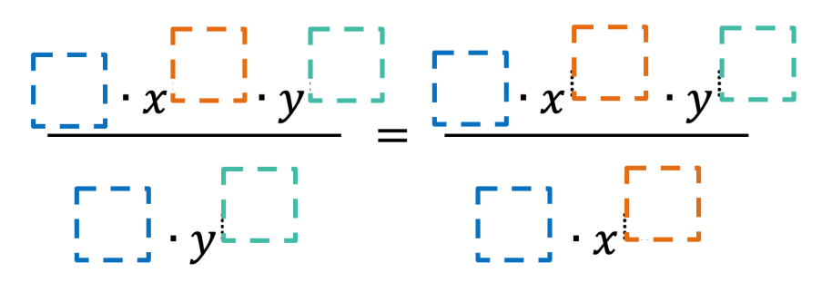
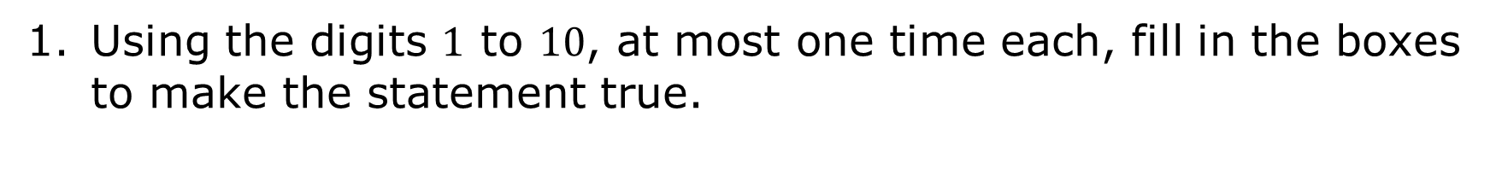
2.3.1 Warm-Up: Dividing Monomials
Using the digits $1$ to $10$, at most one time each, fill in the boxes to make the statement true.
volume 1, pg. 68
Notes:
Video Link: https://algebranation.wistia.com/medias/fi4fidi5y8

Slide 7

Guided Practice
volume 1, pg. 68

Slide 8

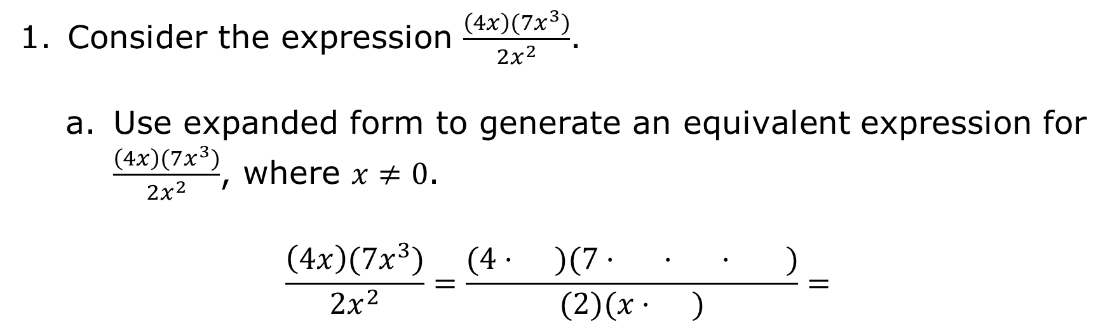
2.3.2 Guided Practice: Using Different Methods to Generate Equivalent Expressions
Consider the expression $\frac{\left(4x\right)(7x^{3})}{2x^{2}}$.
Use expanded form to generate an equivalent expression for $\frac{\left(4x\right)(7x^{3})}{2x^{2}}$, where $x≠0$.
$$\frac{\left(4x\right)(7x^{3})}{2x^{2}}=\frac{(4· )(7· · · )}{(2)(x· )}=$$
volume 1, pg. 68

Slide 9
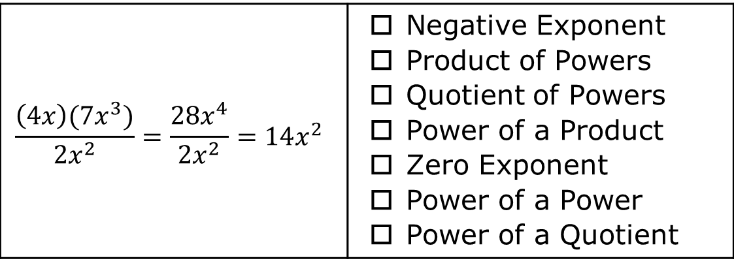
For the expression shown, indicate the laws of exponents used to generate the equivalent expressions.
$$\frac{\left(4x\right)(7x^{3})}{2x^{2}}=\frac{28x^{4}}{2x^{2}}=14x^{2}$$ | Negative Exponent Product of Powers Quotient of Powers Power of a Product Zero Exponent Power of a Power Power of a Quotient
volume 1, pg. 68

Slide 10
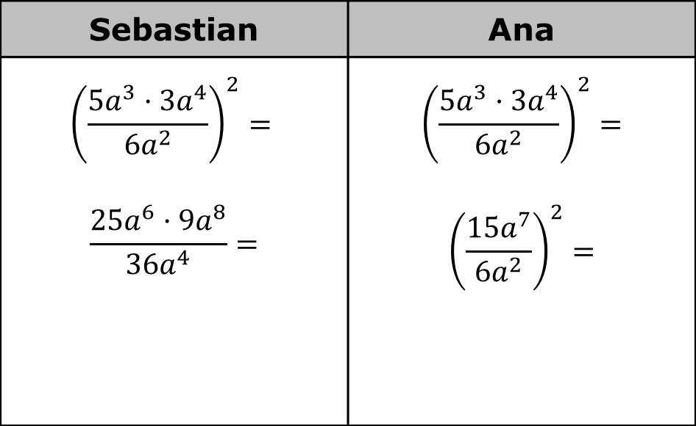
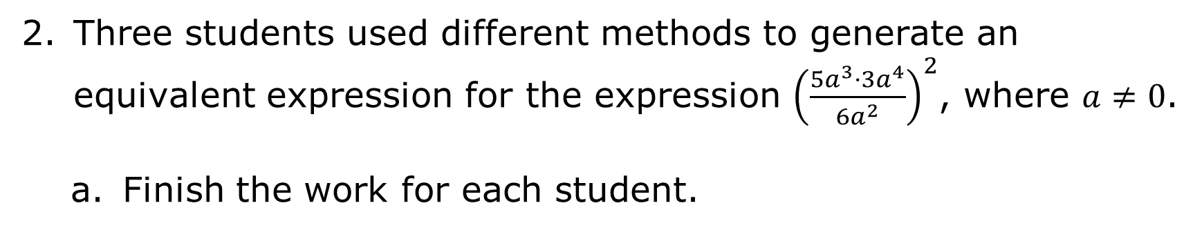
Three students used different methods to generate an equivalent expression for the expression ${\left(\frac{{5a}^{3}·{3a}^{4}}{{6a}^{2}}\right)}^{2}$, where $a≠0$.
Finish the work for each student.
Sebastian | Ana
$${\left(\frac{{5a}^{3}·{3a}^{4}}{{6a}^{2}}\right)}^{2}=$$ $$\frac{25a^{6}·{9a}^{8}}{{36a}^{4}}=$$ | $${\left(\frac{{5a}^{3}·{3a}^{4}}{{6a}^{2}}\right)}^{2}=$$ $${\left(\frac{{15a}^{7}}{6a^{2}}\right)}^{2}=$$
volume 1, pg. 69

Slide 11
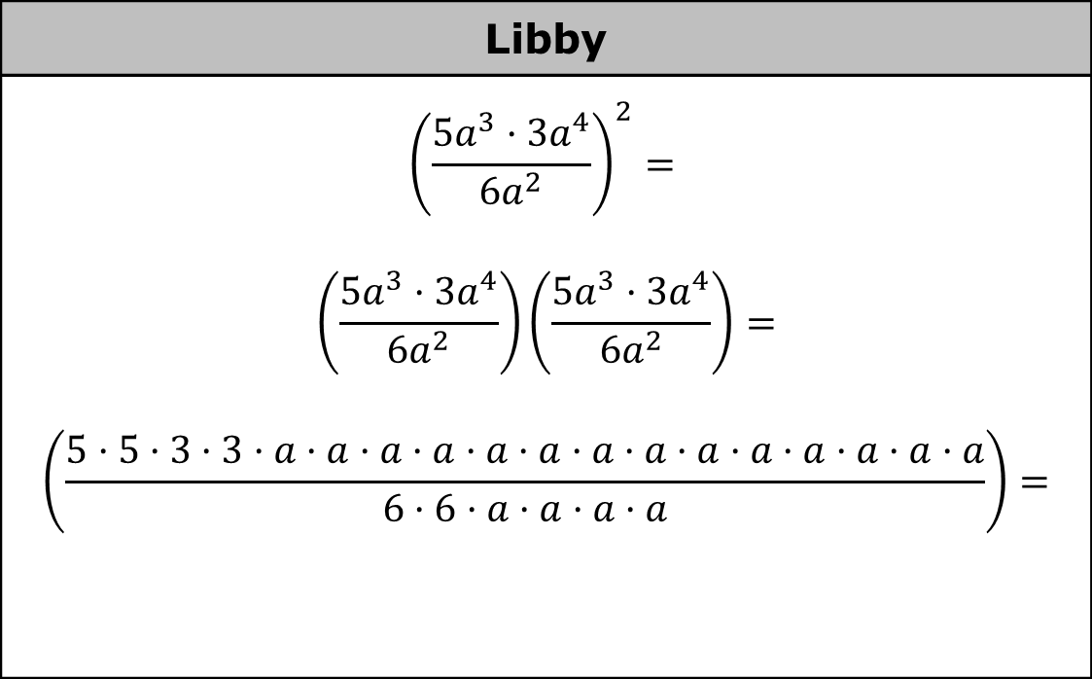
Libby
$${\left(\frac{{5a}^{3}·{3a}^{4}}{{6a}^{2}}\right)}^{2}=$$ $$\left(\frac{{5a}^{3}·{3a}^{4}}{{6a}^{2}}\right)\left(\frac{{5a}^{3}·{3a}^{4}}{{6a}^{2}}\right)=$$ $$\left(\frac{5·5·3·3·a·a·a·a·a·a·a·a·a·a·a·a·a·a}{6·6·a·a·a·a}\right)=$$
Discuss with your partner the differences in the methods used by each student. Then, determine if the different methods each produced the same equivalent expression.
volume 1, pg. 69

Slide 12

Try It
volume 1, pg. 70

Slide 13
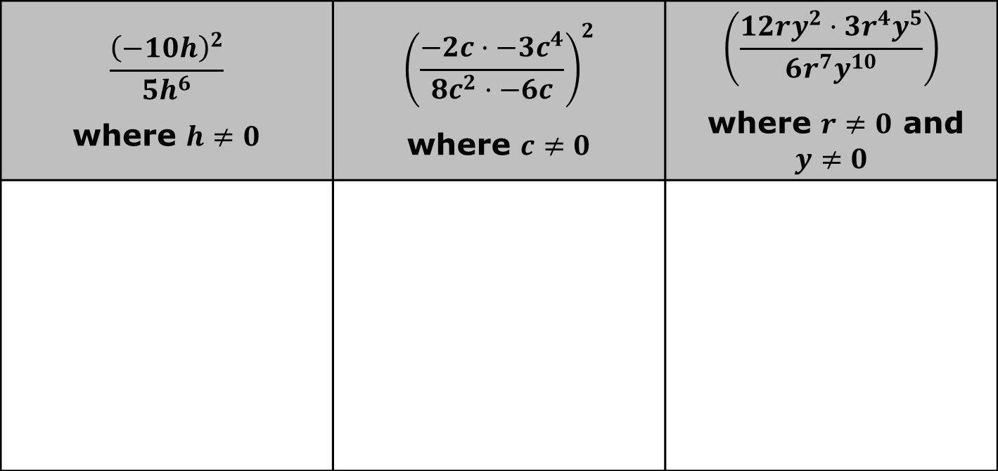
2.3.3 Try It: Generating Equivalent Algebraic Expressions
For each of the following, find an equivalent expression.
$$\frac{{\left(−10h\right)}^{2}}{5h^{6}}$$ where $h≠0$ | $${\left(\frac{−2c·−3c^{4}}{{8c}^{2}·−6c}\right)}^{2}$$ where $c≠0$ | $$\left(\frac{12ry^{2}·3r^{4}y^{5}}{6r^{7}y^{10}}\right)$$ where $r≠0$ and $y≠0$
volume 1, pg. 70

Slide 14
Compare your answers with your partner and resolve any differences, if necessary.
Compare and discuss the methods you used to create each equivalent algebraic expression.
volume 1, pg. 70

Slide 15

Bring It Together
volume 1, pg. 70

Slide 16
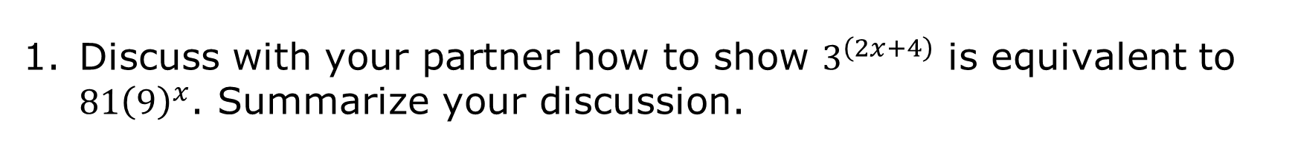
2.3.4 Bring It Together: Generating Multiple Equivalent Algebraic Expressions
Discuss with your partner how to show $3^{\left(2x+4\right)}$ is equivalent to $81{\left(9\right)}^{x}$. Summarize your discussion.
volume 1, pg. 70

Slide 17
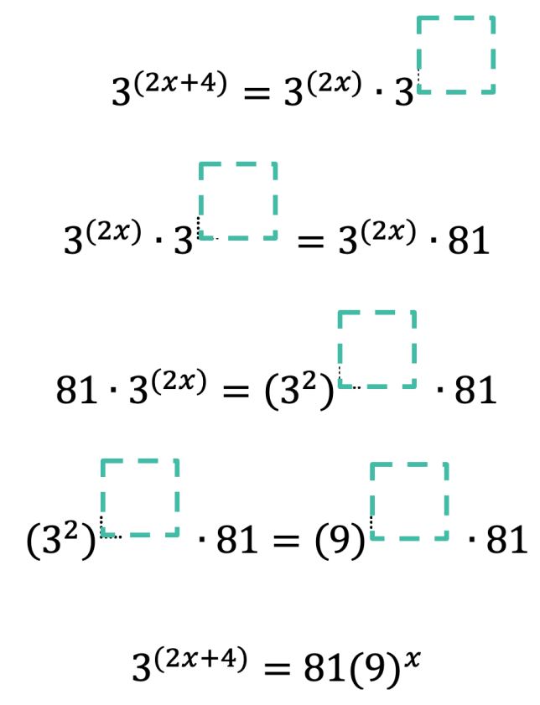
Prove $3^{\left(2x+4\right)}=81{\left(9\right)}^{x}$ by filling in the value for each blank.
volume 1, pg. 70

Slide 18

Prove $z^{\left(5y−6\right)}=\frac{{\left(z^{5}\right)}^{y}}{z^{6}}$ by using the laws of exponents. Show your work.
Use the laws of exponents to write two equivalent expressions for ${1.2}^{\left(4+2x\right)}$. Show your work.
volume 1, pg. 71

Slide 19

Your Turn
volume 1, pg. 71

Slide 20

2.3.5 Your Turn!
Write an equivalent expression for $3^{{9r}^{2}}⋅3^{9r}$ using the laws of exponents.
volume 1, pg. 71

Slide 21

Prove ${2.1}^{\left(3x+1\right)}=2.1{\left(9.261\right)}^{x}$ by using the laws of exponents. Show your work.
Use the law of exponents to write two equivalent expressions for ${6.2}^{\left(2−3x\right)}$. Show your work.
volume 1, pg. 71

Slide 22

Wrap-Up
volume 1, pg. 72

Slide 23
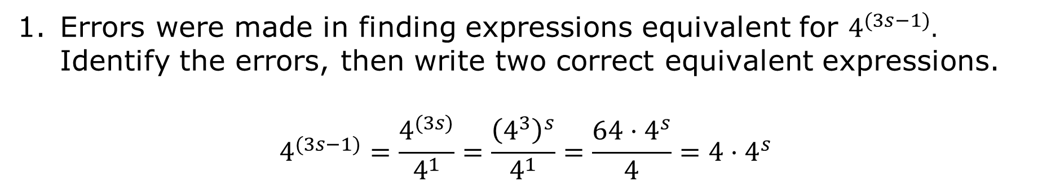
2.3.6 Wrap-Up: Error Analysis
Errors were made in finding expressions equivalent for $4^{(3s−1)}.$ Identify the errors, then write two correct equivalent expressions.
$$4^{(3s−1)}=\frac{4^{(3s)}}{4^{1}}=\frac{{\left(4^{3}\right)}^{s}}{4^{1}}=\frac{{64⋅4}^{s}}{4}=4⋅4^{s}$$
volume 1, pg. 72

